Slide 1
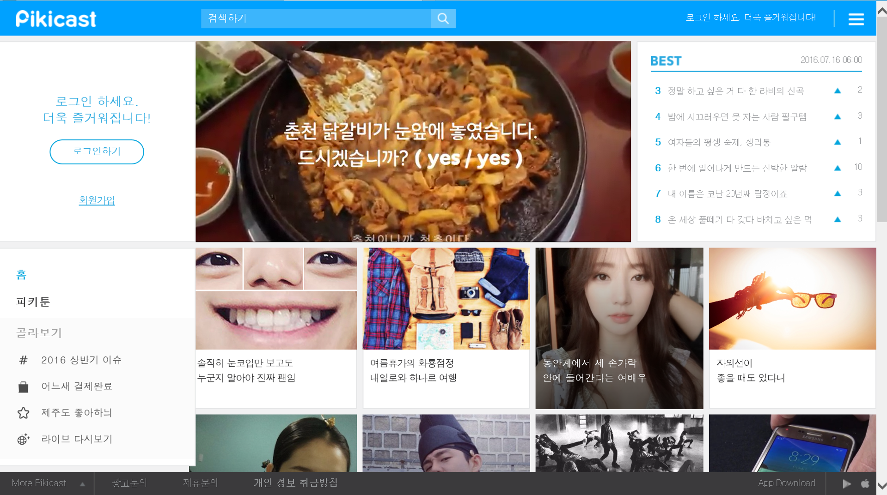
3
5
1
2
4
9
6
7
8
10
13
14
11
12
15
Notes:
1. Head_Logo
2. Head_Search_Text
3. Head_Search_Btn
4. Head_Text
5. Head_Menu
6. Aside_Text
7. Aside_Login_Btn
8. Aside_Regist_Btn
9. 미정
10. Aside_Home
11. Category_Title
12. Category_# ( #은 연속성이 있는 숫자 )
13. Contents_List
14. Contents_#
15. Footer_Menu

Slide 2
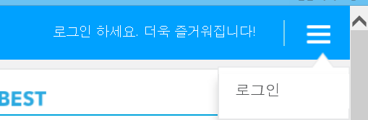
2
3
1
4
Notes:
1. Head_Text
2. Head_Push
3. Head_Menu
4. Head_Menu_Btn_#

Slide 3
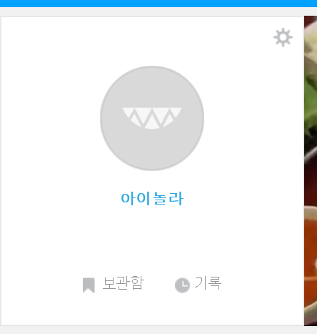
1
2
3
4
Notes:
1. Aside_Profile_Modify
2. Aside_Profile
3. Aside_Profile_Name
4. Aside_Menu_Btn_#

Slide 4
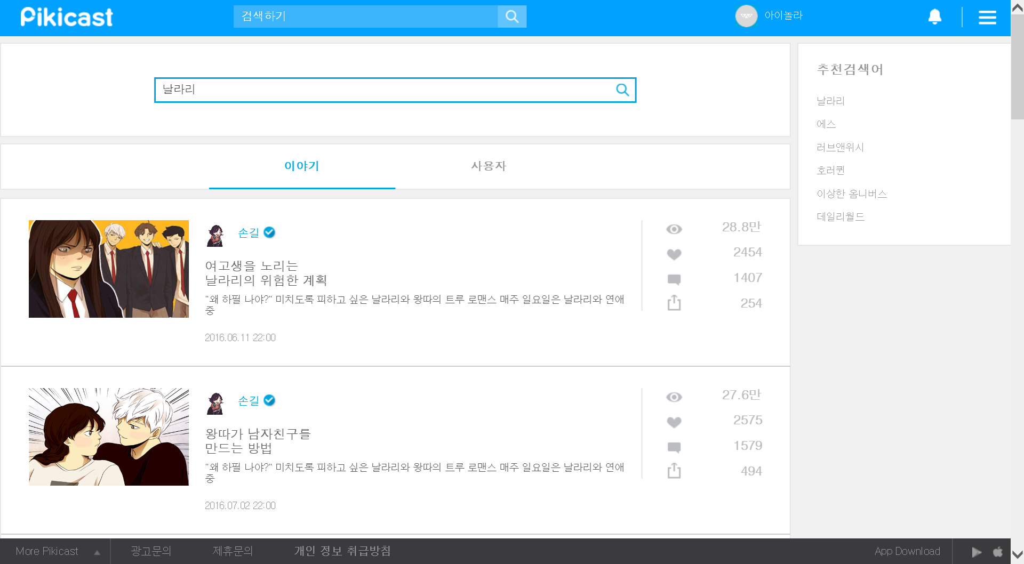
1
3
2
4
5
Notes:
1. Search_Text
2. Search_Btn
3. Search_Keyword
4. Search_Menu_Btn_#
5. Search_Centents_#

Slide 5
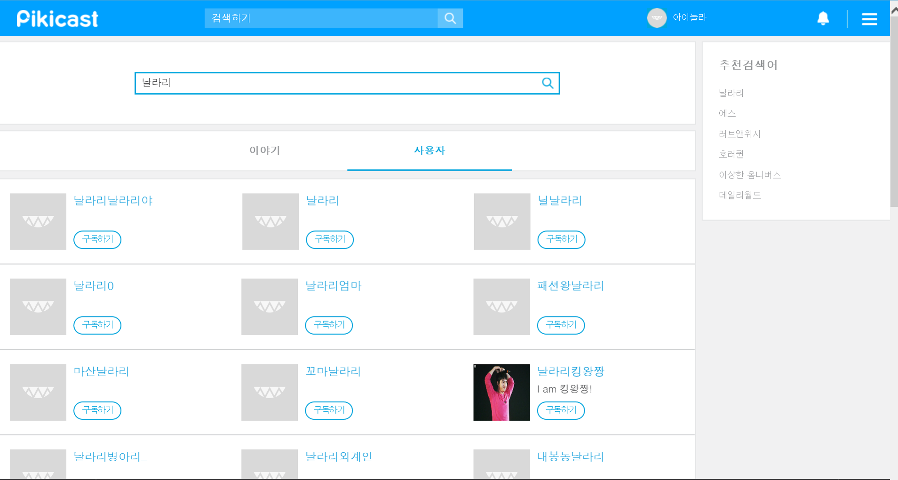
1
Notes:
1. Search_User_#

Slide 6
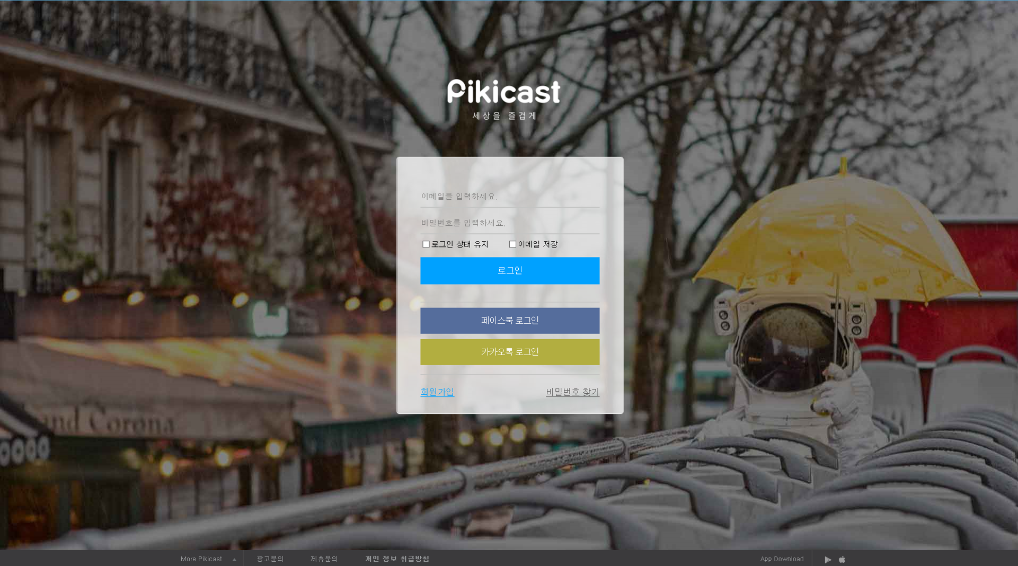
1
2
3
4
5
6
7
8
9
Notes:
1. Login_Logo
2. Login_Email_Text
3. Login_PW_Text
4. Login_Save_Email_Check
5. Login_Login_Btn
6. Login_FB_Login_Btn
7. Login_KT_Login_Btn
8. Login_Regist_Btn
9. Login_Search_PW_Btn

Slide 7
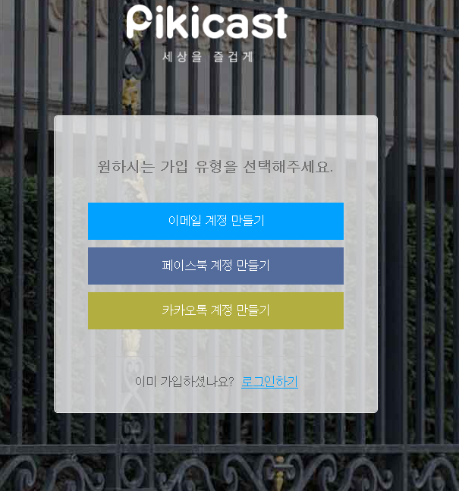
1
2
3
4
6
5
Notes:
1. Register_Title
2. Register_Email_Btn
3. Register_FB_Btn
4. Register_KT_Btn
5. Register_Already_Text
6. Register_Already_Go_Login

Slide 8
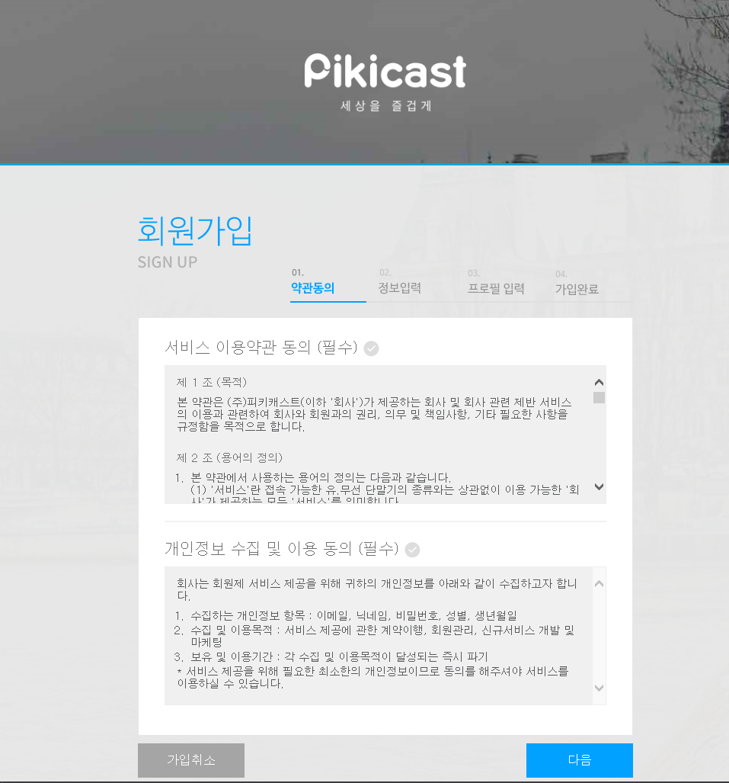
1
2
2
3
Notes:
Regist_Contents
Regist_Contents_Check
Regist_Previous
Regist_Next

Slide 9
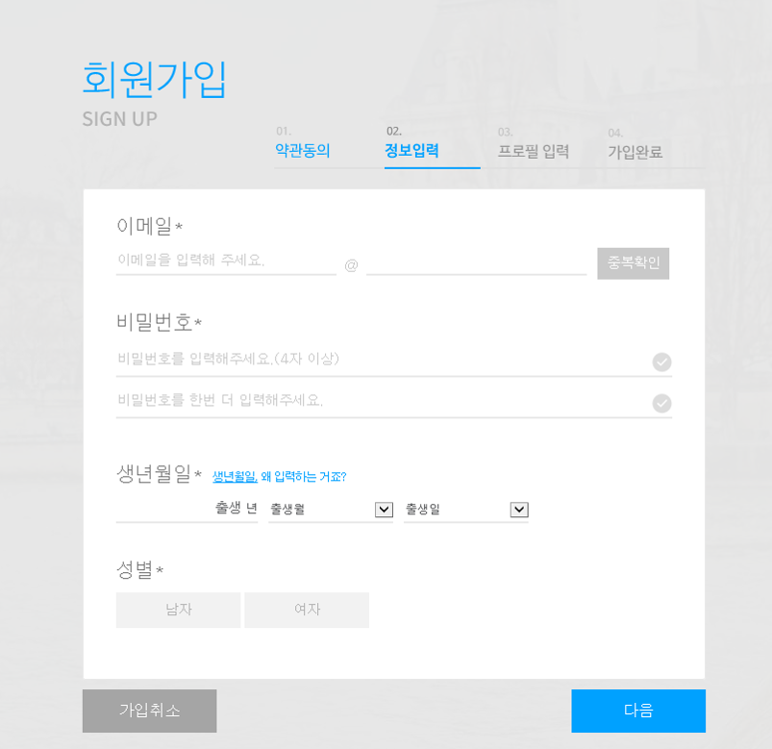
1
3
2
4
5
6
7
8
9
10
11
12
Notes:
1. Regist_Email_Title
2. Regist_Email_Text
3. Regist_Email_Check_Btn
4. Regist_ PW_Title
5. Regist_PW_Text
6. Regist_PW_Check
7. Regist_PW_Confirm_Text
8. Regist_PW_Confirm_Check
9. Regist_Birth_Title
10. Regist_Birth_Text
11. Regist_Sex_Title
12. Regist_Sex_Radio

Slide 10
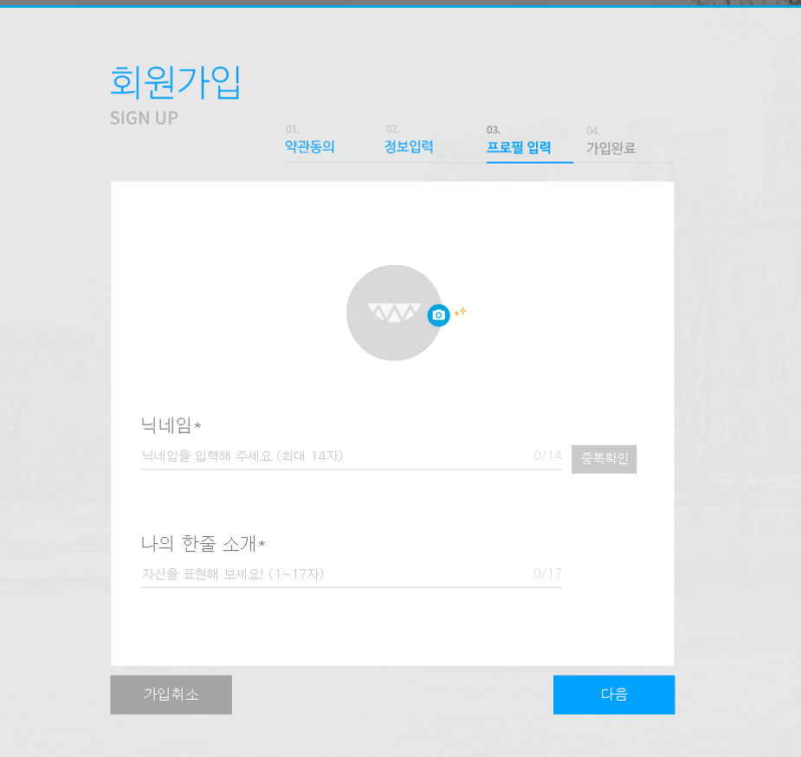
1
2
5
3
4
6
7
8
Notes:
1. Regist_Profile_Image
2. Regist_Profile_Name_Title
3. Regist_Profile_Name_Text
4. Regist_Profile_Name_Count
5. Regist_Profile_Name_CheckBtn
6. Regist_Profile_Introduce_Title
7. Regist_Profile_Introduce_Text
8. Regist_Profile_Introduce_Count

Slide 11
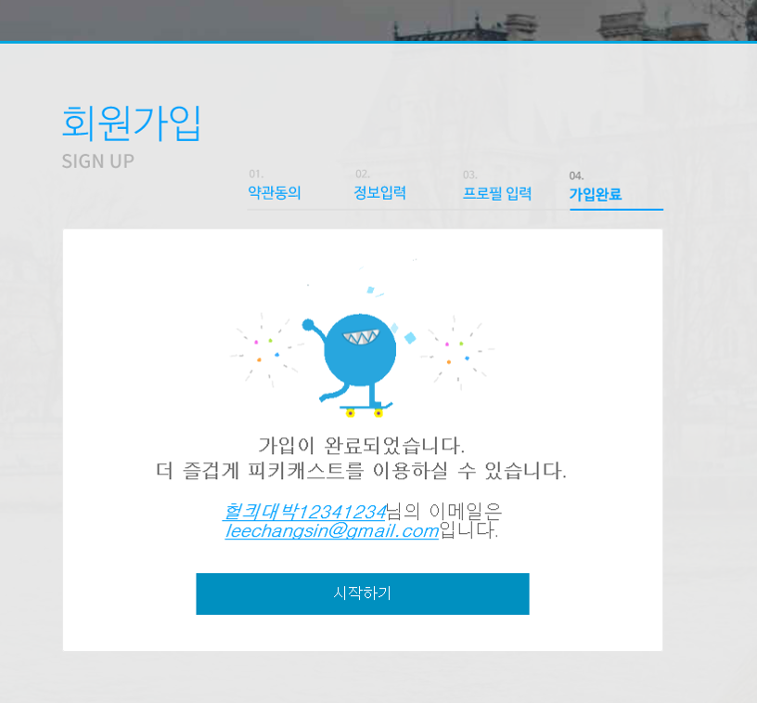
1
2
3
Notes:
1. Regist_Profile_Name_Text
2. Regist_Email_Text
3. Regist_Go_Main

Slide 12
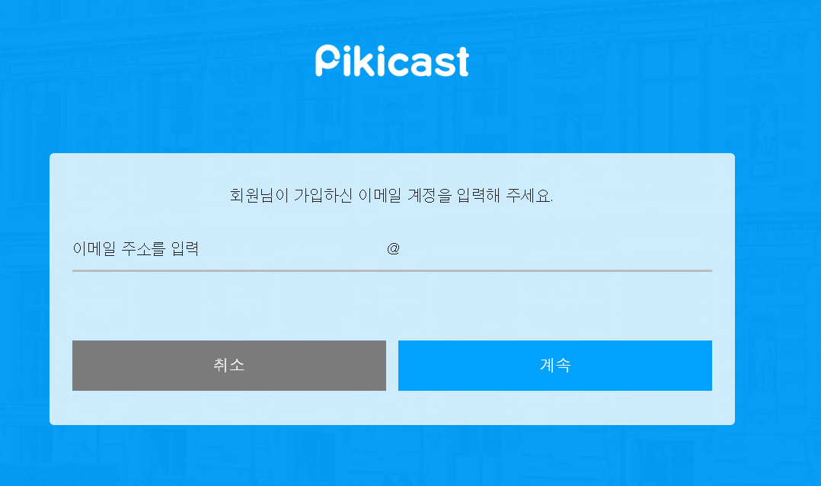
1
2
3
4
6
5
Notes:
1. PW_Search_Logo
2. PW_Search_Title
3. PW_Search_Input_Text
4. PW_Search_ERR
5. PW_Search_Previous ( 취소라는 텍스트를 이전으로 변경하면 좋겠다 )
6. PW_Search_Next

Slide 13
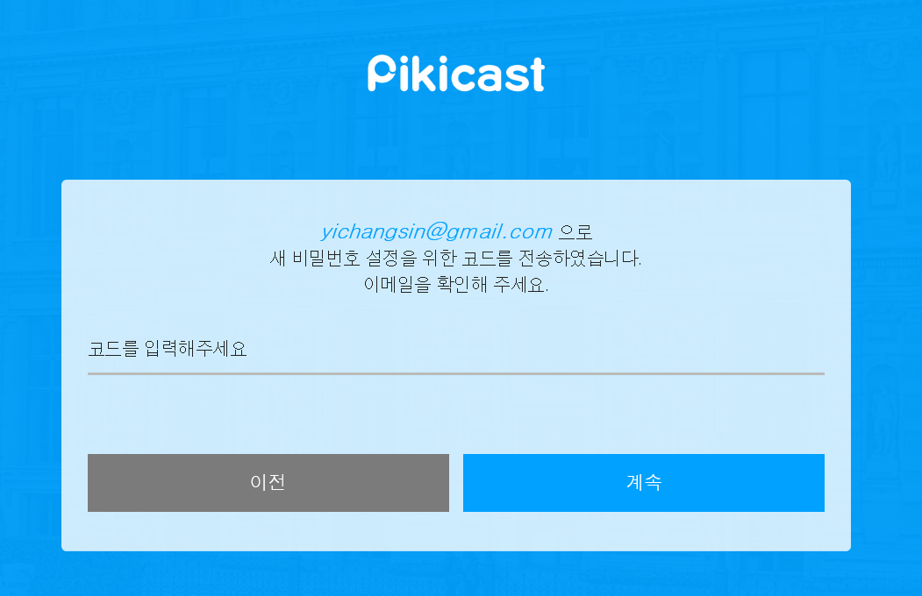
1
2
3
5
4
Notes:
1. PW_Search_Title
2. PW_Search_Input_Text
3. PW_Search_ERR
4. PW_Search_Previous
5. PW_Search_Next

Slide 14
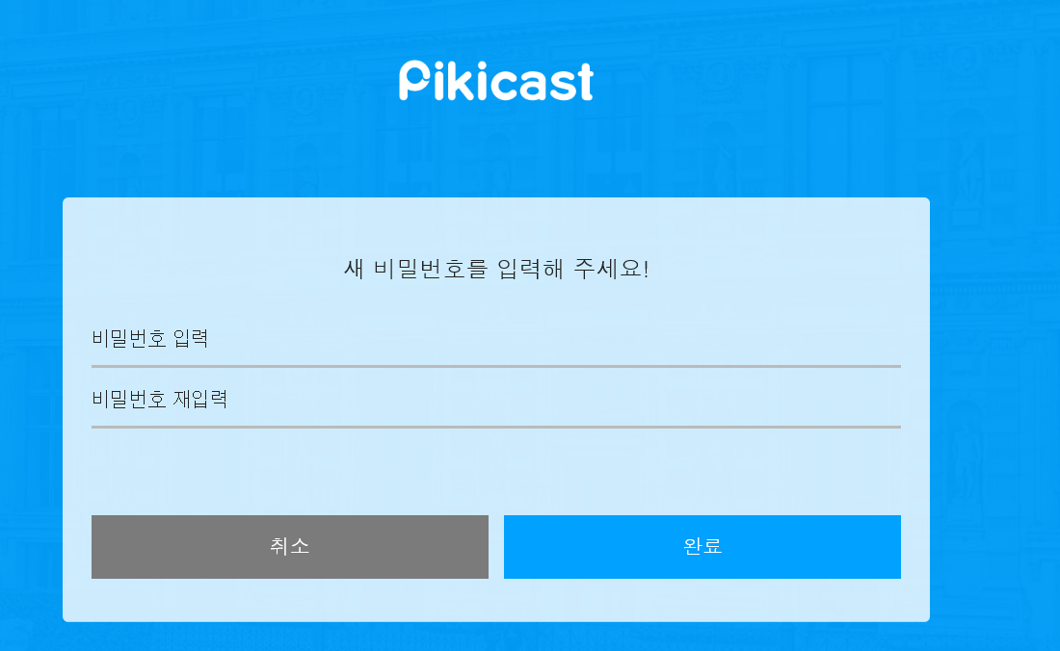
1
2
3
4
6
5
Notes:
1. PW_Search_Title
2. PW_Search_Input_Text
3. PW_Search_Input_Confirm_Text
4. PW_Search_ERR
5. PW_Search_Previous
6. PW_Search_Next

